Slide 1
Chapter 3
JUMP, LOOP and CALL Instructions

Slide 2
Outlines
Loop instructions
Conditional jump instructions
Conditions determining conditional jump
Unconditional long & short jumps
Calculate target addresses for jumps
Subroutines
Using stack in subroutines
Crystal frequency vs. machine cycle
Code programs to generate time delay

Slide 3
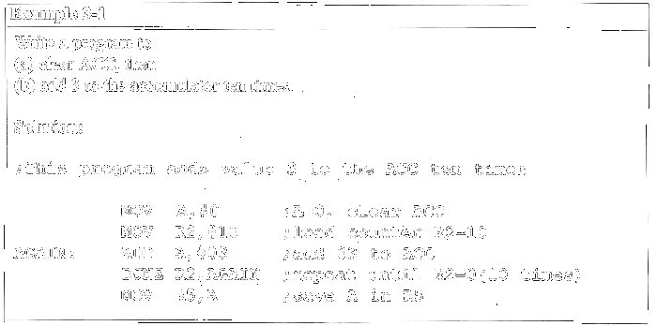
Looping

Slide 4
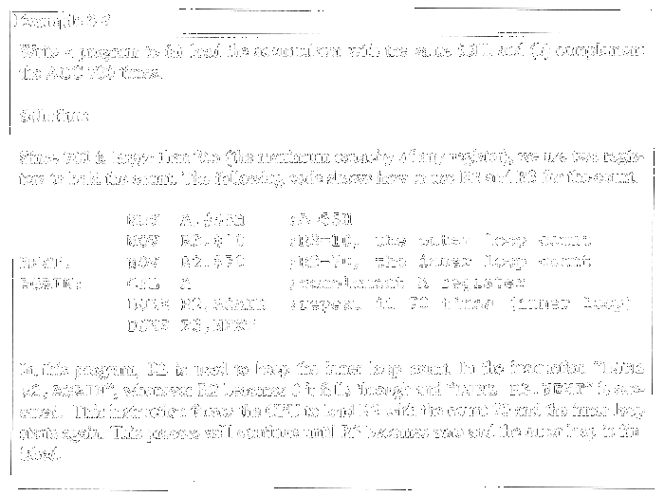
Loop inside a Loop (Nested Loop)

Slide 5
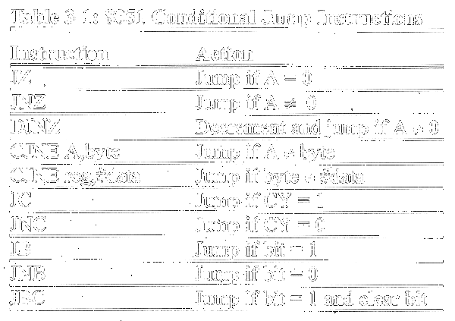
8051 Conditional Jump Instructions

Slide 6
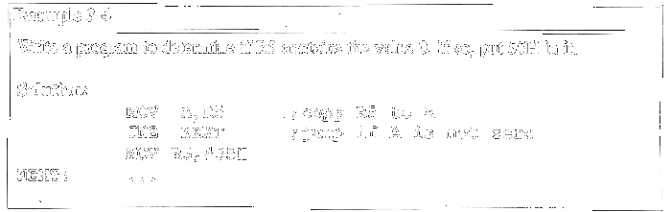
Conditional Jump Example

Slide 7
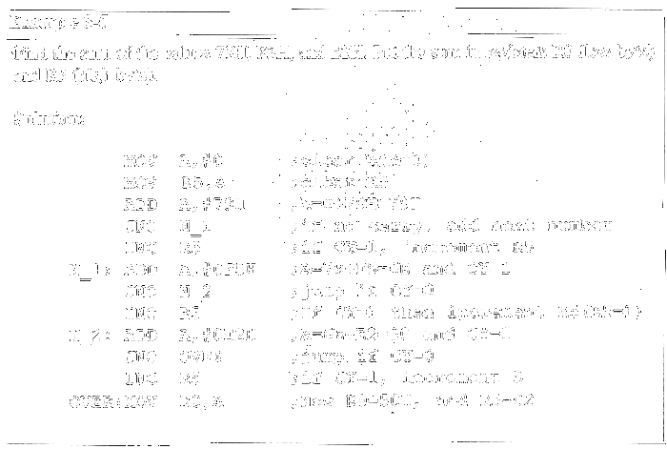
Conditional Jump Example

Slide 8
Unconditional Jump Instructions
All conditional jumps are short jumps
  Target address within -128 to +127 of PC
LJMP (long jump): 3-byte instruction
  2-byte target address: 0000 to FFFFH
  Original 8051 has only 4KB on-chip ROM
SJMP (short jump): 2-byte instruction
  1-byte relative address: -128 to +127

Slide 9
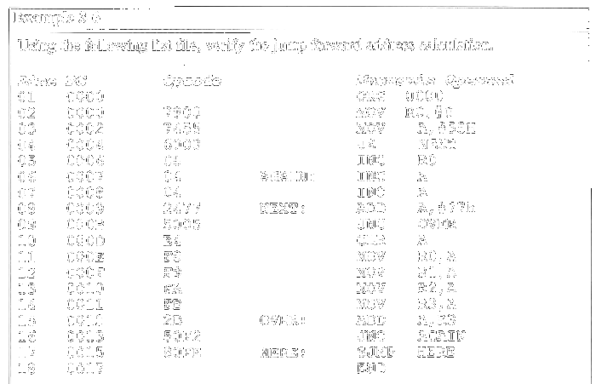
Calculating Short Jump Addresses

Slide 10
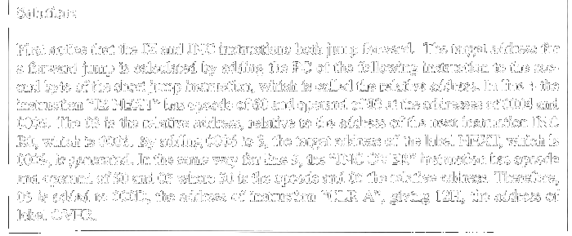
Calculating Short Jump Addresses

Slide 11
Call Instructions
LCALL (long call): 3-byte instruction
  2-byte address
  Target address within 64K-byte range
ACALL (absolute call): 2-byte instruction
  11-bit address
  Target address within 2K-byte range

Slide 12
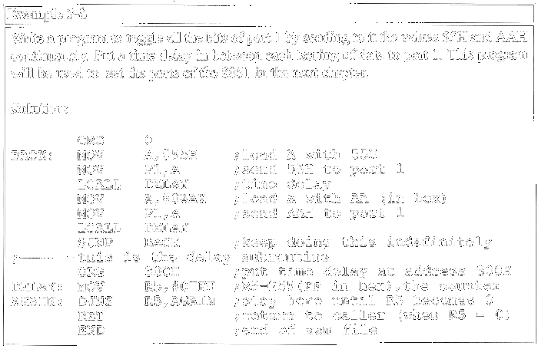
LCALL

Slide 13
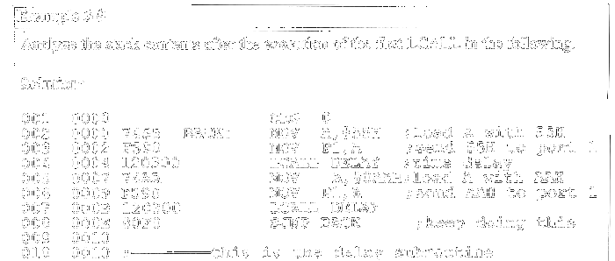
CALL Instruction & Role of Stack

Slide 14
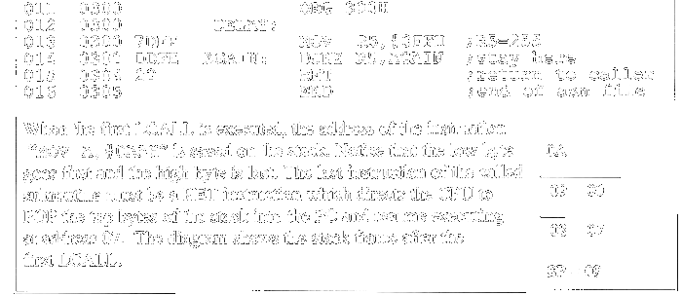
CALL Instruction & Role of Stack

Slide 15
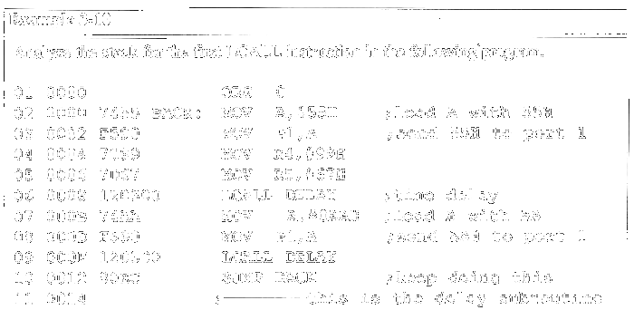
Using PUSH & POP in Subroutines

Slide 16
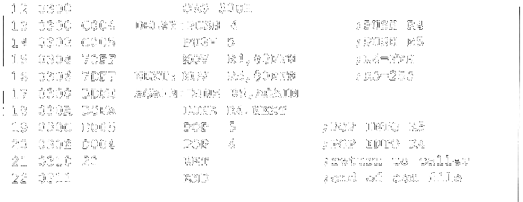
Using PUSH & POP in Subroutines

Slide 17
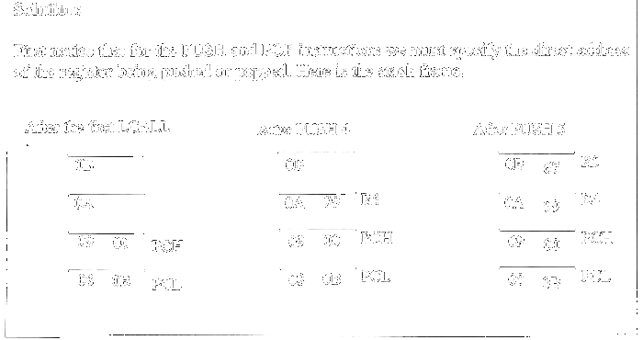
Using PUSH & POP in Subroutines

Slide 18
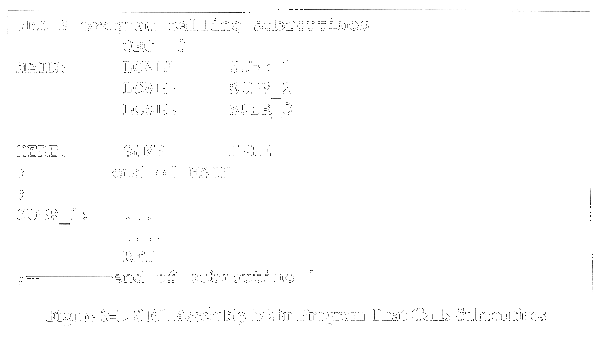
Calling Subroutines

Slide 19
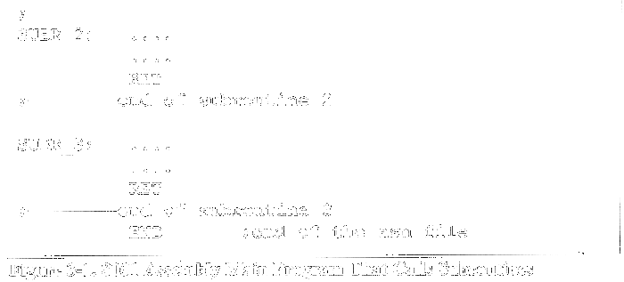
Calling Subroutines

Slide 20
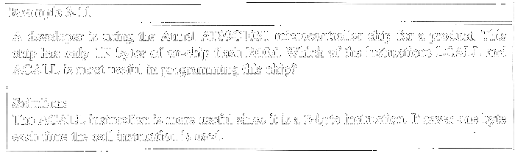
ACALL (absolute call)

Slide 21
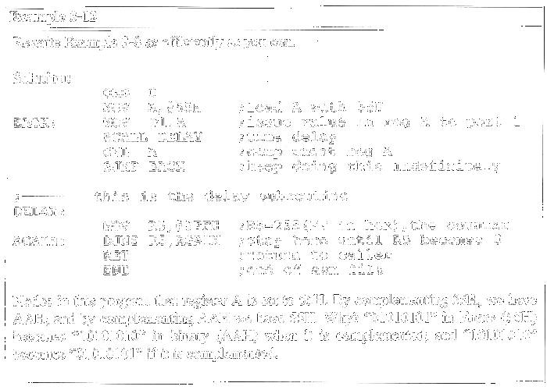
Programming Efficiently

Slide 22
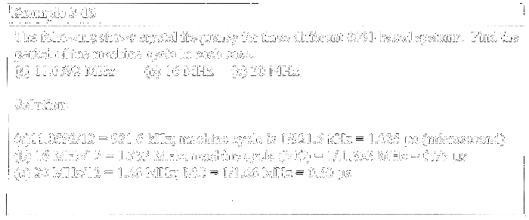
Time Delay Generation & Calculation
1 instruction = n × machine cycle
1 machine cycle = 12 clock cycles

Slide 23
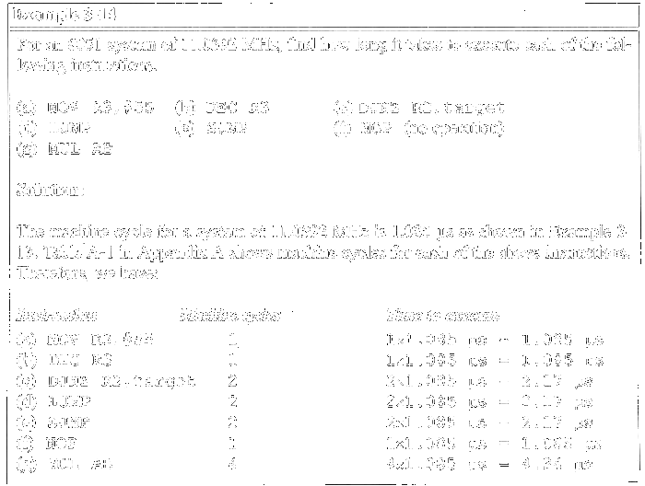
Delay Calculation

Slide 24
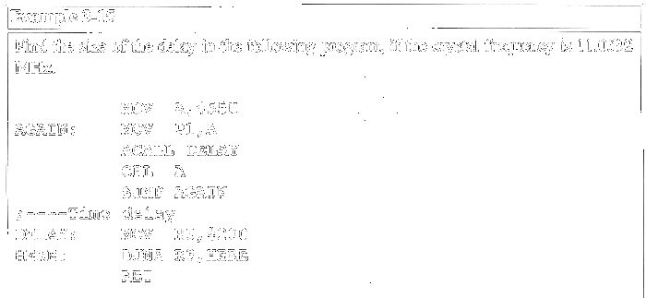
Delay Calculation Example

Slide 25
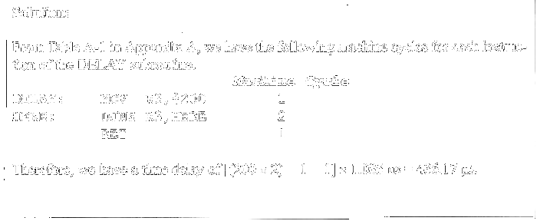
Delay Calculation Example

Slide 26
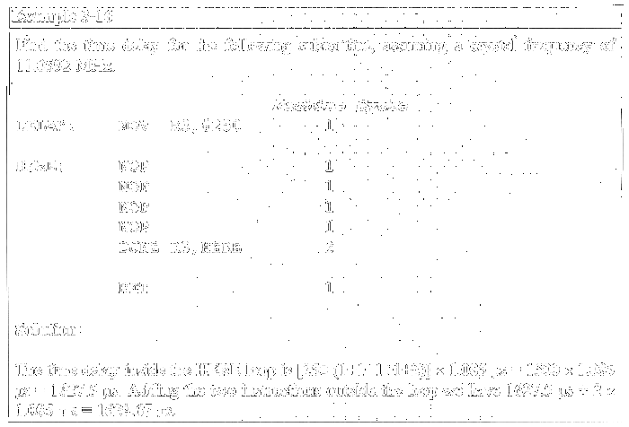
Increasing Delay Using NOP

Slide 27
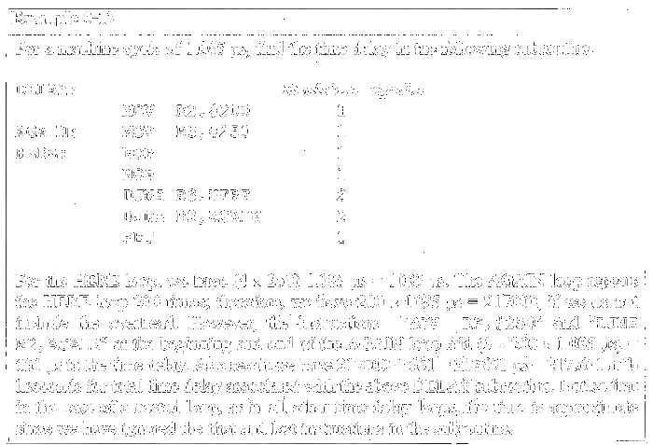
Large Delay Using Nested Loop

